Slide 1


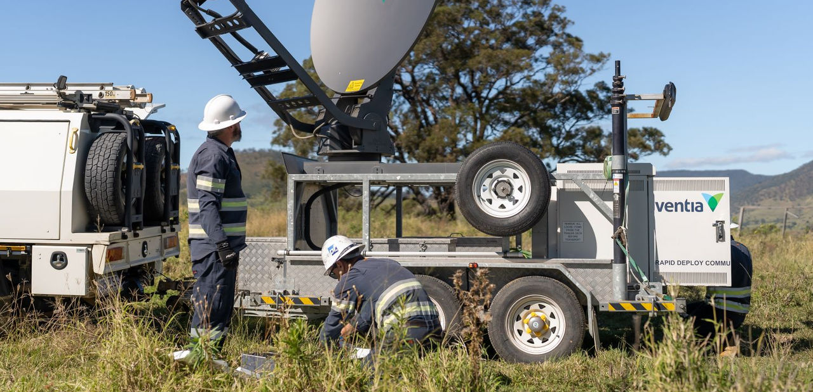
Lecture 1 Introduction

Slide 2
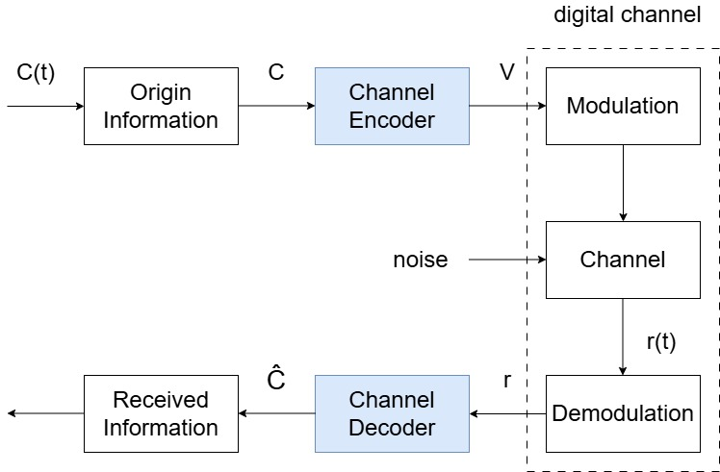
Digital Telecommunication System

Slide 3
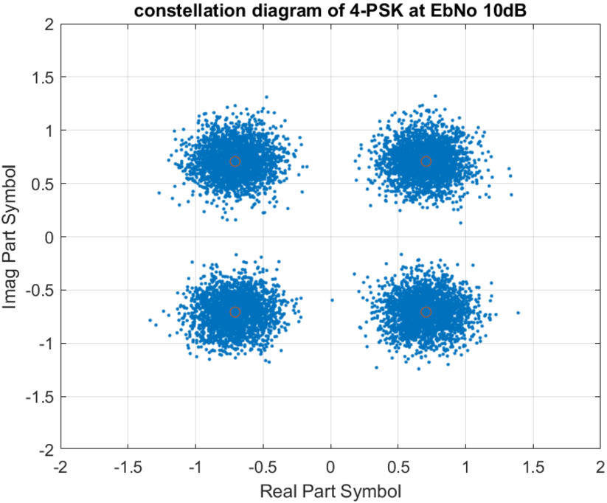
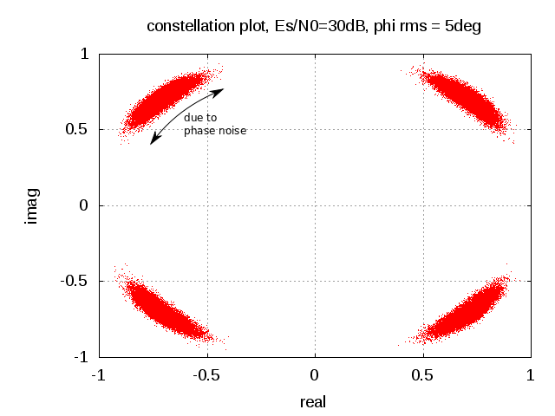

Noise
Noise always exists.
Noise: unwanted waves that tend to disturb the transmission and processing of message signal in a communication system
> Internal or external <
We quantify noise effect by SNR, i.e., the ratio of the average signal power to the average noise power
$$SNR=10\log_{10}\left(\frac{P_{s}}{P_{0}}\right)=10\log_{10}\left(\frac{E_{s}/T}{WN_{0}}\right)=10\log_{10}\left(\frac{E_{s}}{N_{0}}\right)$$
where $P_{s}$ is the average signal power, $P_{0}$ is the average noise power, $W$ is the signal bandwidth, $T=\frac{1}{W}$ is the time slot to count the average, $E_{s}$ is the signal energy during the time slot and $N_{0}$ is the noise power spectrum density.
thermal noise
phase noise

Slide 4
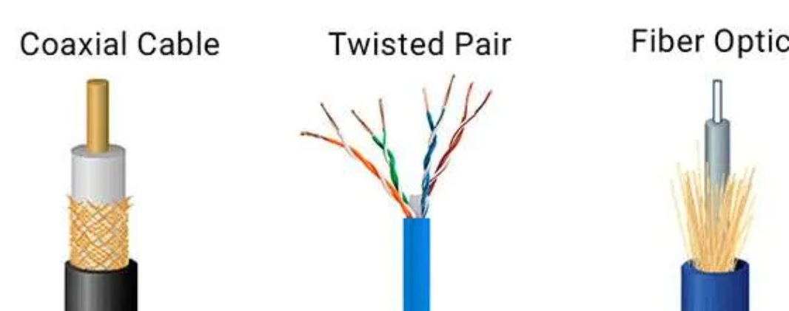
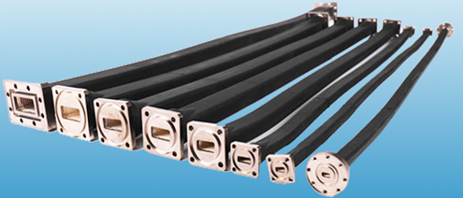
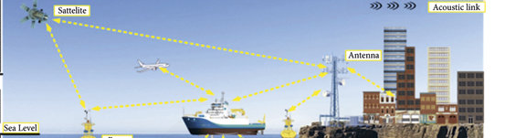
Channels
Wire/Guide channel (time invariant and Bandwidth limited)
Traditional cables: telephone lines, coax cables, optical fiber
Wave Guide
Wireless channel (time variant and power limited)
Broadcast channels: usually line-of-sight(LOS) and linear: wireless radio
Mobile radio channels: usually multipath signals not LOS,
Satellite channels: broad area coverage but nonlinear, low SNR

Slide 5
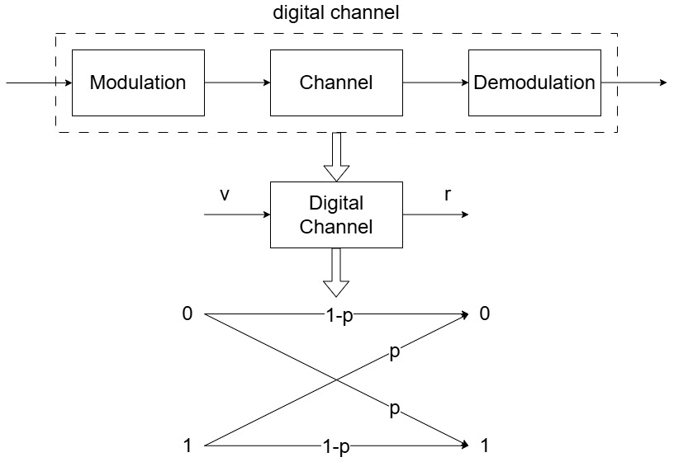

Binary Symmetric Channel (BSC)
When the demodulator applies hard decisions, modulation, the channel and demodulation can be simplified as a digital channel.
The digital channel is modelled by a Binary Symmetric Channel (BSC) with a bit error probability $p$

Slide 6
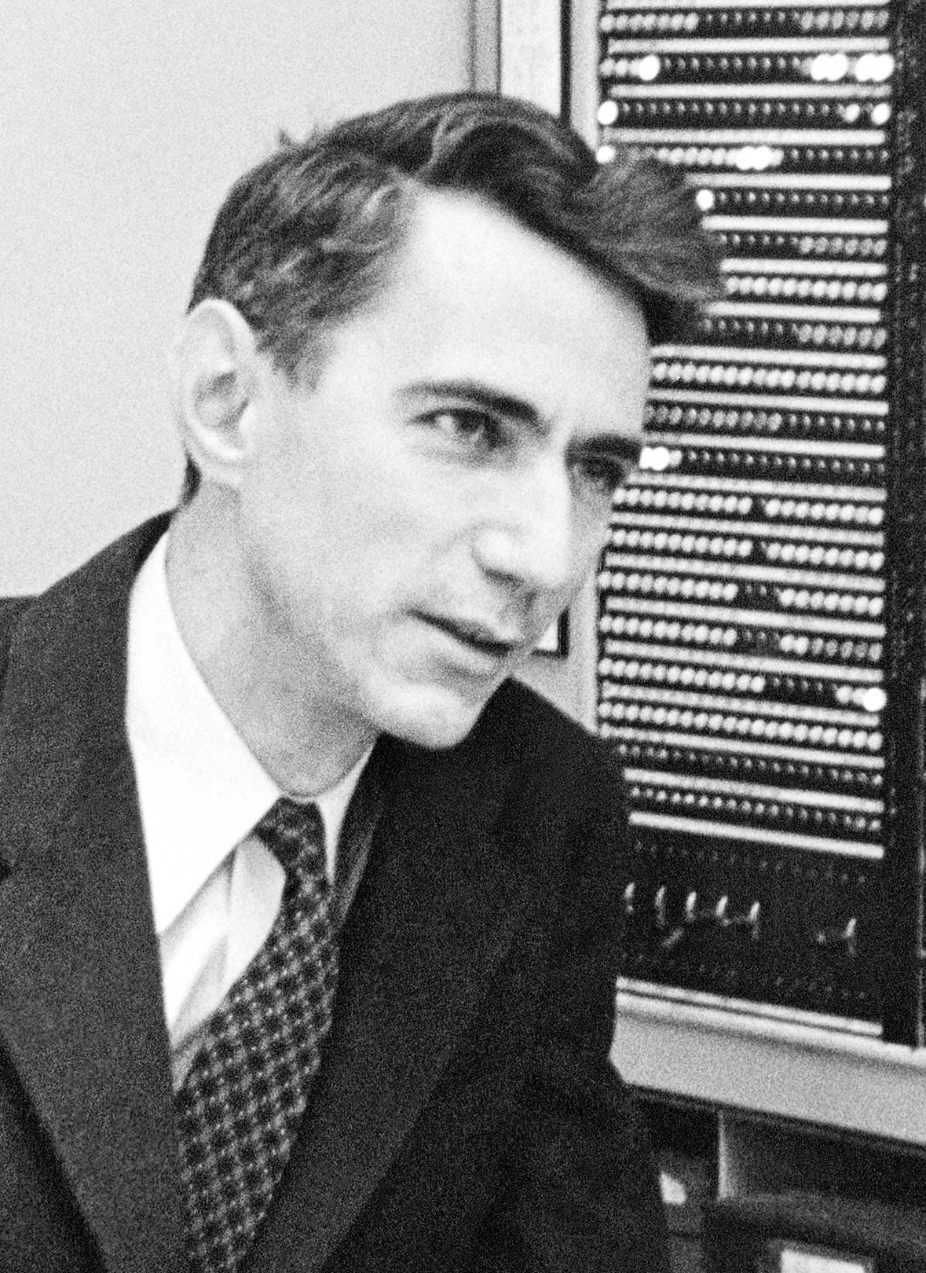

Channel Capacity
Shannon Noisy Channel Coding Theorem
Every channel has a capacity C.
If we transmit at a data rate less than the capacity, there exists an error control code that provides an arbitrarily low bit error rate.
For an AWGN channel the capacity is
$$C=Blog_{2}\left(1+SNR\right)=Blog_{2}\left(1+\frac{P_{s}}{BN_{0}}\right)(bps)$$
where B is the channel bandwidth.
Therefore, the maximum spectral efficiency is
$$η=\frac{C}{B}=log_{2}\left(1+SNR\right)=log_{2}\left(1+\frac{P_{s}}{BN_{0}}\right)bps/Hz$$

Slide 7
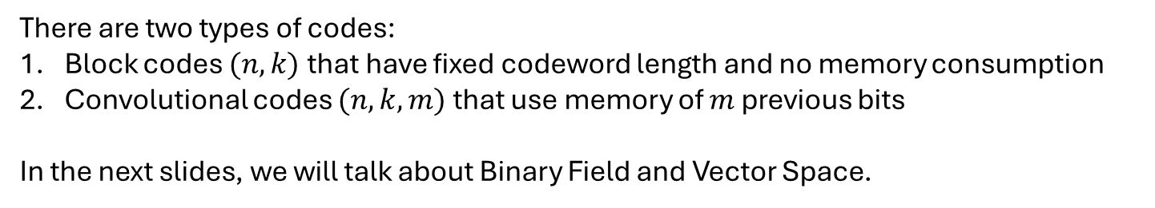
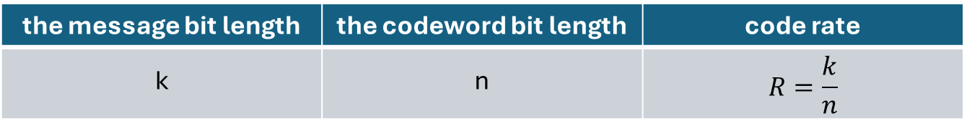
Basic Coding Knowledge
The channel code is also called Forward Error Correcting (FEC) Code
the message bit length | the codeword bit length | code rate
k | n | $$R=\frac{k}{n}$$
There are two types of codes:
Block codes $(n, k)$that have fixed codeword length and no memory consumption
Convolutional codes $(n, k, m)$that use memory of $m$ previous bits
In the next slides, we will talk about Binary Field and Vector Space.

Slide 8
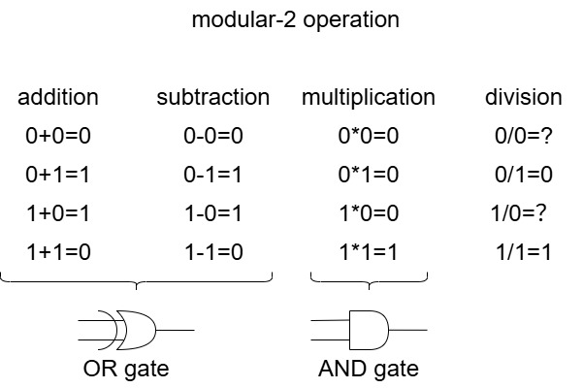
Binary Field
Field: a set of elements in which we can perform addition, subtraction, division and multiplication without leaving the set.
Binary Field denoted by GF(2): the set {0,1} together with modulo-2 addition, multiplication, subtraction and division.

Slide 9
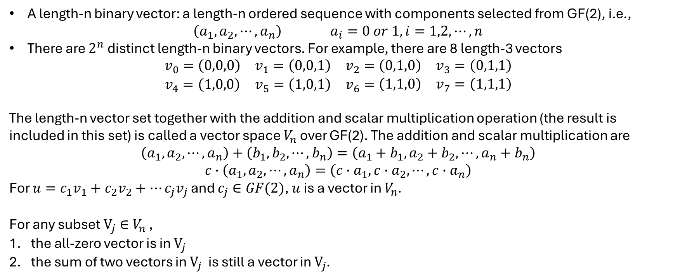
Vector Space
A length-n binary vector: a length-n ordered sequence with components selected from GF(2), i.e.,
$$\left(a_{1}, a_{2},⋯,a_{n}\right) a_{i}=0 or 1, i=1,2,⋯,n$$
There are $2^{n}$ distinct length-n binary vectors. For example, there are 8 length-3 vectors
$$\begin{matrix}v_{0}=\left(0,0,0\right) & v_{1}=\left(0,0,1\right) & v_{2}=\begin{matrix}\left(0,1,0\right) & v_{3}=\left(0,1,1\right)\end{matrix} \\ v_{4}=\left(1,0,0\right) & v_{5}=\left(1,0,1\right) & v_{6}=\begin{matrix}\left(1,1,0\right) & v_{7}=\left(1,1,1\right)\end{matrix}\end{matrix}$$
The length-n vector set together with the addition and scalar multiplication operation (the result is included in this set) is called a vector space $V_{n}$ over GF(2). The addition and scalar multiplication are
$$\left(a_{1}, a_{2},⋯,a_{n}\right)+\left(b_{1}, b_{2},⋯,b_{n}\right)=\left(a_{1}+b_{1}, a_{2}+b_{2},⋯,a_{n}+b_{n}\right)$$
$$c∙\left(a_{1}, a_{2},⋯,a_{n}\right)=\left(c∙a_{1}, {c∙a}_{2},⋯,{c∙a}_{n}\right)$$
For $u=c_{1}v_{1}+c_{2}v_{2}+⋯c_{j}v_{j}$ and $c_{j}∈GF(2)$, $u$ is a vector in $V_{n}$.
For any subset $V_{j}∈V_{n}$ ,
the all-zero vector is in $V_{j}$
the sum of two vectors in $V_{j}$ is still a vector in $V_{j}$.

